Slide 1
Retail Store Management System
IST654.M003.Information System Analysis

Slide 2
Executive Summary
The Retail Store Management System (RSMS) is a software solution designed to simplify retail operations, increase efficiency, and reduce costs.
The project aims to develop a comprehensive system that can manage every aspect of retail operations, including inventory, sales, and customer interactions.
The RSMS offers features for real-time inventory management, sales analytics, employee management, and marketing tools.
This system can help retailers make data-driven decisions, identify top-selling products, and forecast future sales trends.
With the RSMS, retailers can increase sales, cut waste, and maintain optimal inventory levels.

Slide 3

Business Case
Increased Sales Revenue
Improved Inventory Management
Enhanced Customer Satisfaction
Improved Business Performance

Slide 4
Actors/ Users
CUSTOMERS
STAFF
ADMIN
SYSTEM USER

Slide 5
Functional Requirements
Improved inventory management
Customer Relationship Management
Sales tracking and reporting
Integration with other systems

Slide 6
Non- Functional Requirements
Performance: The system should be able to handle high volumes of transactions and users, with fast response times and minimal downtime.
Security: The system should ensure the confidentiality, integrity, and availability of sensitive data, such as customer and financial information, and protect against unauthorized access and cyber-attacks.
Usability: The system should be user-friendly, with a clear and intuitive interface, and support for multiple languages and accessibility requirements.
Reliability: The system should be highly available, with a high level of fault-tolerance, backup and recovery mechanisms, and minimal data loss.
Scalability: The system should be able to scale up or down as needed, to accommodate changes in business requirements and user demand.
Compatibility: The system should be compatible with existing hardware, software, and networks, and support interoperability with third-party systems and devices.
Compliance: The system should comply with relevant laws, regulations, and industry standards.

Slide 7
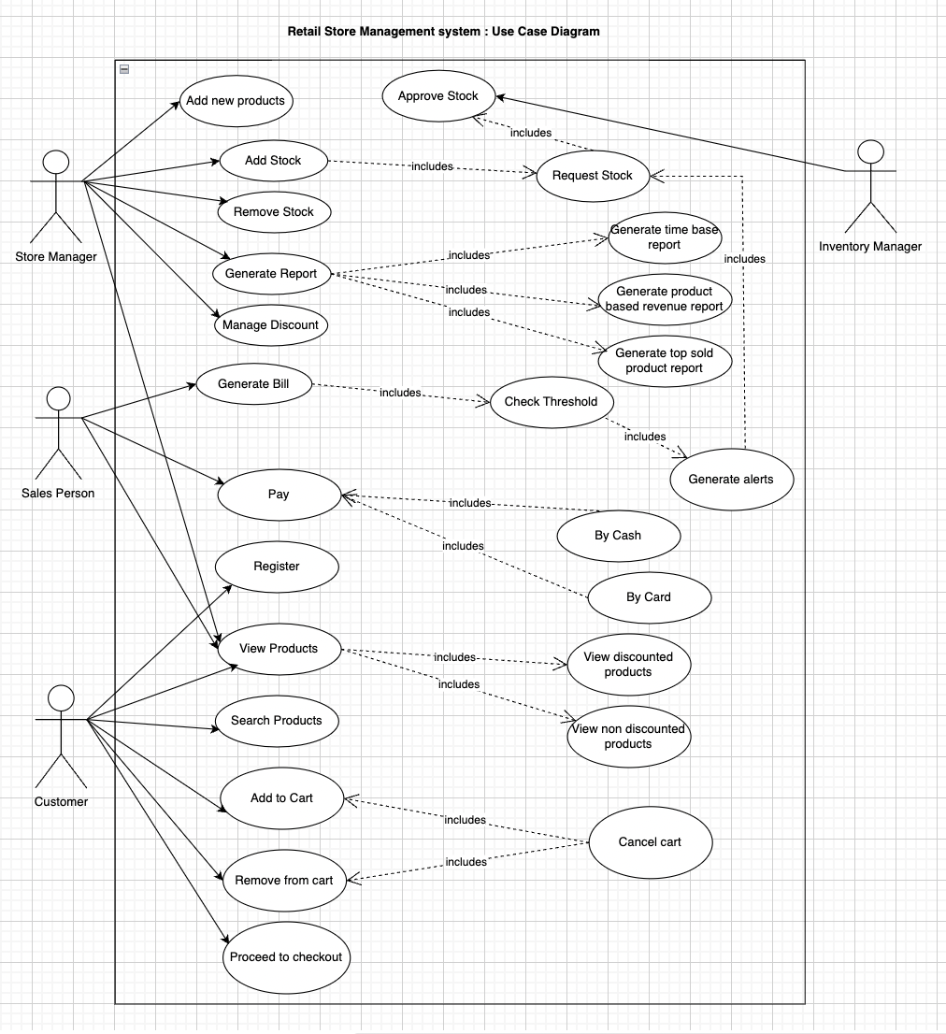
Use-Case diagram

Slide 8
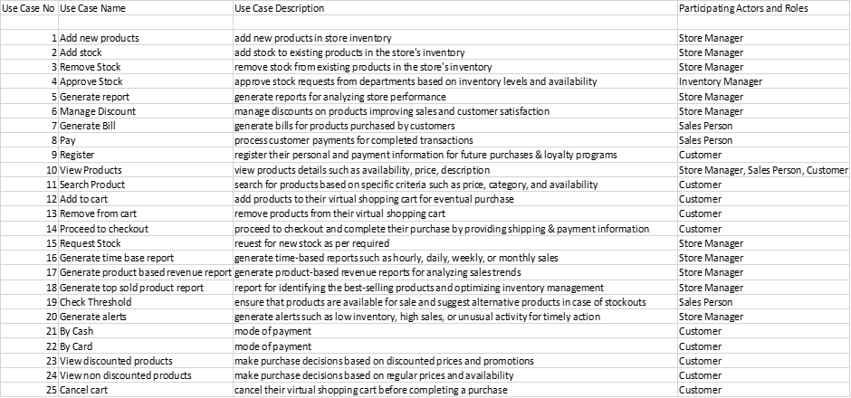
Use- Case Glossary

Slide 9
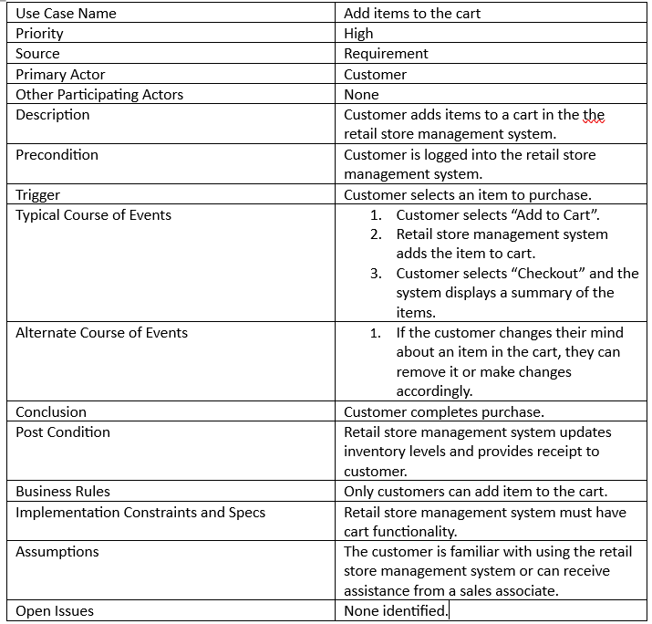
Use- Case Narrative

Slide 10
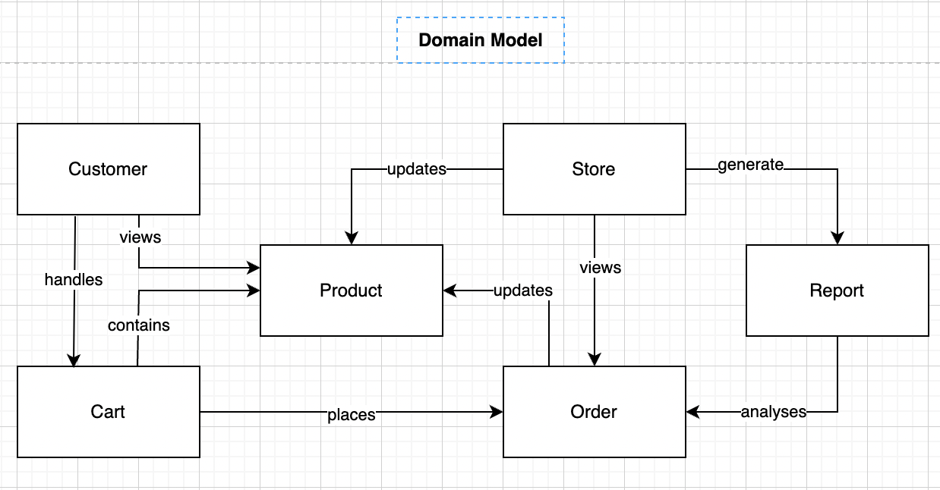
Domain Diagram

Slide 11
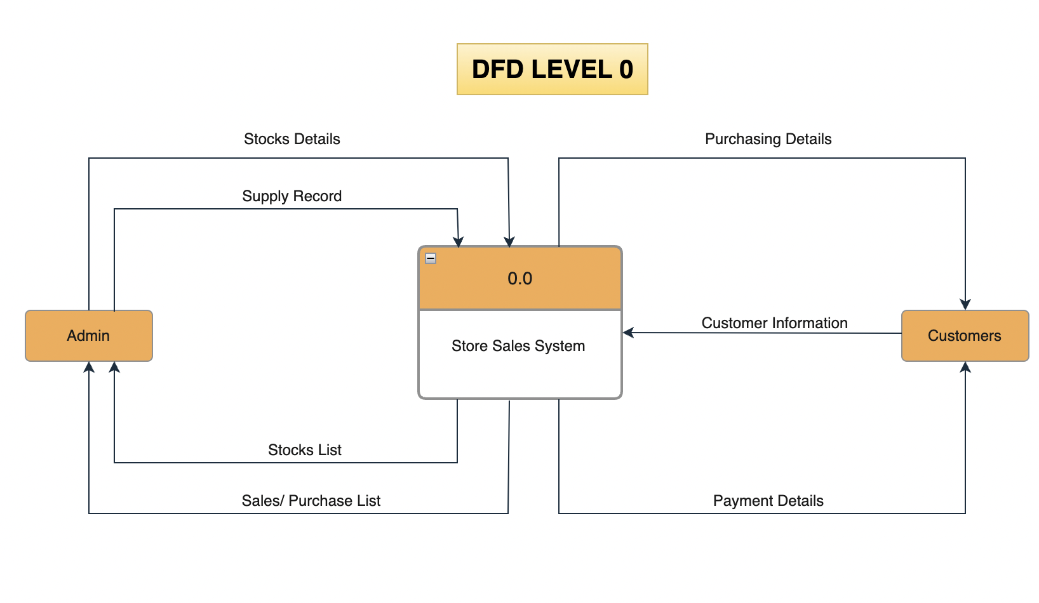
System Diagram

Slide 12
Economic Feasibility
Development Cost distribution
Website building- 3000-$5000
Domain and hosting- $1000/month
Branding- $5000-$10000
Payment gateways – around 3% per transaction
Marketing- $10000-$20000
Miscellaneous- $10000

Slide 13
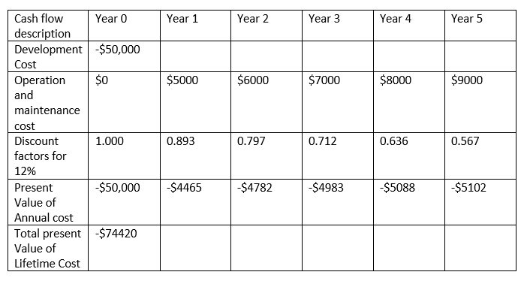
Economic Feasibility
Net Present Value

Slide 14
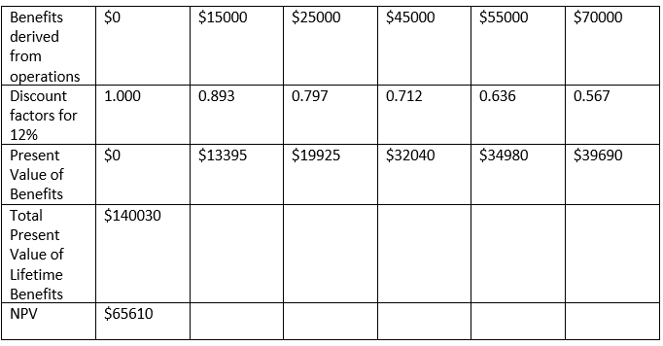
Economic Feasibility

Slide 15
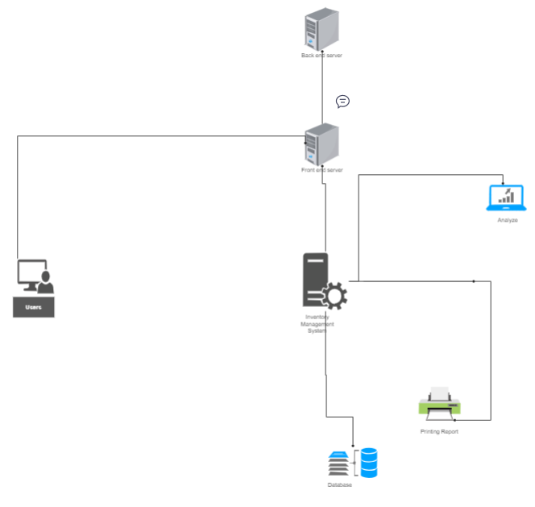




ARCHITECTURE DIAGRAM
Back end server
Firewall
Front end server
Internet
Reports
Application server
Browser
Inventory management system
Database server

Slide 16
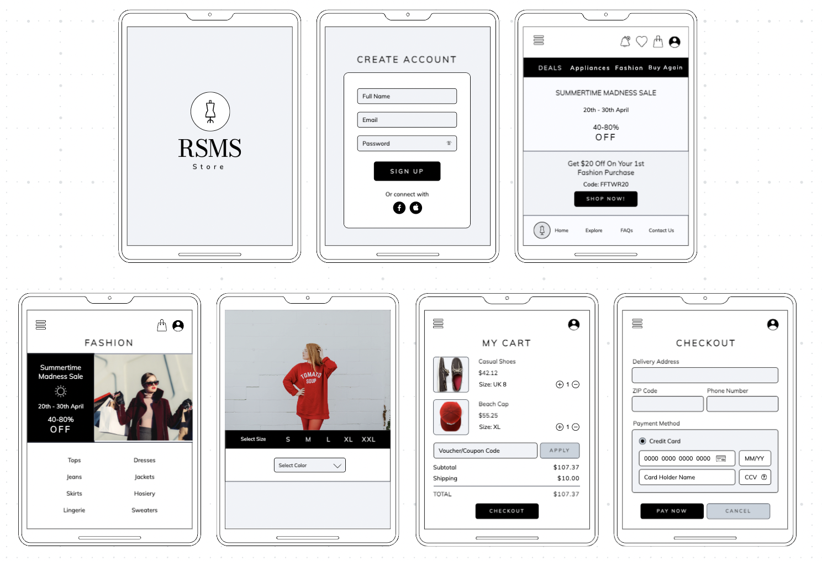
User Interface

Slide 17
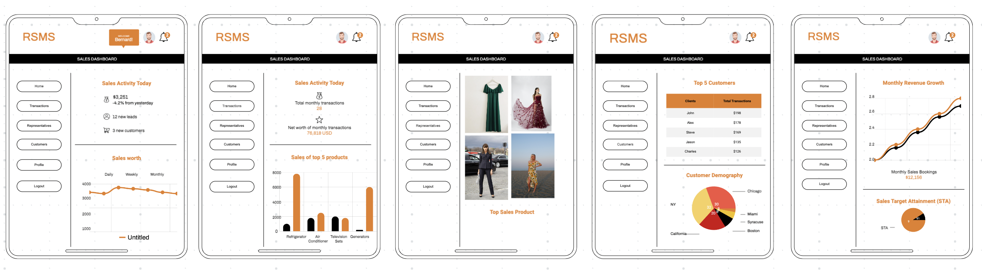
User Interface

Slide 18
Conclusion
In conclusion, a retail store system should be designed to efficiently manage the operations of a retail store, from inventory management to customer management and analytics. By leveraging these features, retailers can improve their operations, enhance the customer experience, and ultimately drive sales growth.
Point-of-sale (POS) transactions: The system should have a user-friendly interface that allows employees to easily process transactions, manage discounts and promotions, and accept multiple forms of payment.
Customer management: The system should be able to manage customer profiles, including their purchase history, contact information, and preferences. This data can be used to create personalized marketing campaigns.
Analytics: The system should be able to generate reports and provide insights on sales trends, inventory levels, and customer behavior. This data can help inform business decisions and improve operations.
Inventory management: The system should be able to track the inventory levels of products and alert when stock is running low. It should also enable you to generate purchase orders and manage the flow of goods.

Slide 19
Thank You

